Slide 1



A Fast Season Length Estimation Using Sliding Discrete Fourier Transform for Time Series Streaming Data
Thanapol Phungtua-eng, Yoshitaka Yamamoto
Department of Informatics, Shizuoka University
15th International Conference on Smart Computing and Artificial Intelligence (SCAI 2024)
2024-07-10
Source code

Slide 2

Outline
Backgroud and motivation
Related works
Proposed online season length estimation method
Experiment results
Conclusions
Backgroud and motivation
Related works
Proposed online season length estimation method
Experiment results
Conclusions
2
Notes:
C

Slide 3
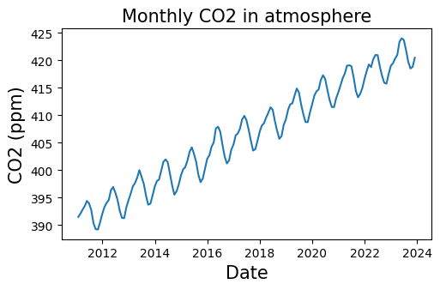
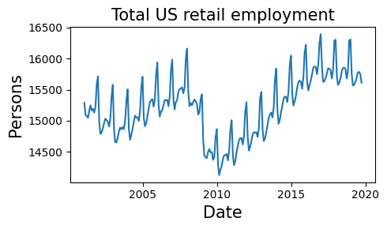
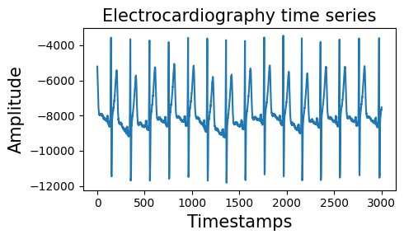



Time series analysis (1)
A time series data is a collection of observations made sequentially over time.
Time series data provide valuable insights for scientists to learn about the behaviors of phenomena.
Meteorology
Finance
Cardiology
** Images were generated by ChatGPT-4.
3

Slide 4
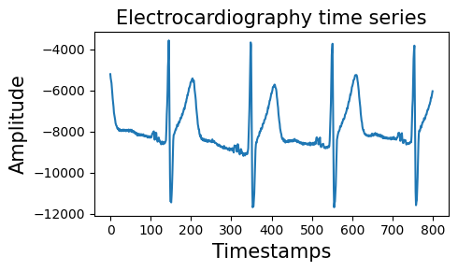
Time series analysis (2)
How do scientists understand behavior using time series data?
Analyzing cyclical behavior in time series
Cyclical behavior, often referred to as “seasonality”, involves recurring patterns or cycles within the time series.
4

Slide 5
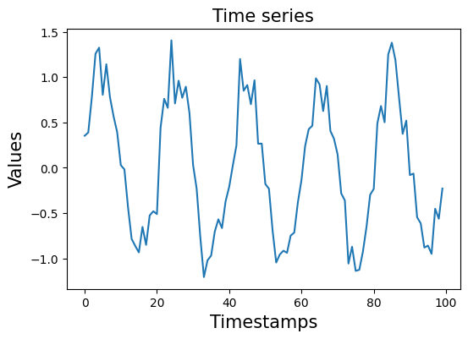
Season length (1)
One cycle
Season length
= 20 timestamps
Main feature of seasonality is “season length”.
It denotes the duration of a single cycle.
Scientists utilize the season length for phenomena monitoring.
Many algorithms for data mining require this as an input parameter.
5

Slide 6
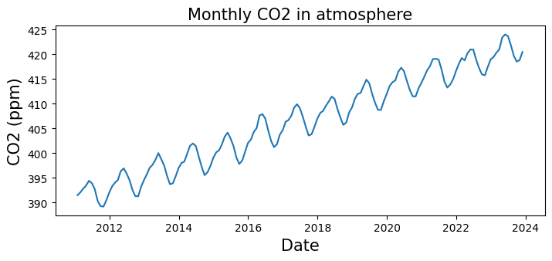
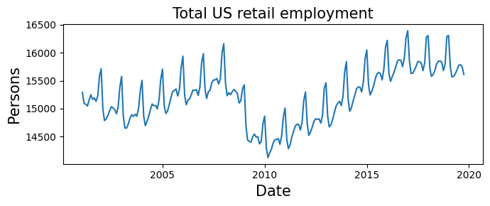
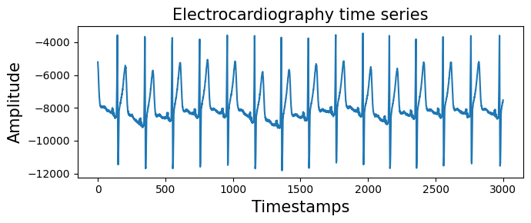
Season length (2)
Human perception is insufficient and misleading for estimating season length.
The season length estimation (SLE) is a technique for providing the season length.
Changing
Difficult to estimate
6
Notes:
actual season length.

Slide 7
Motivation of this research
Motivation:
Can we accurately and quickly estimate the season length for streaming data?
Our contribution:
Our method accurately estimates the season length in streaming data.
Our method quickly estimates the season length in streaming data.
7

Slide 8
Outline
Backgroud and motivation
Related works
Proposed online season length estimation method
Experiment results
Conclusions
8

Slide 9
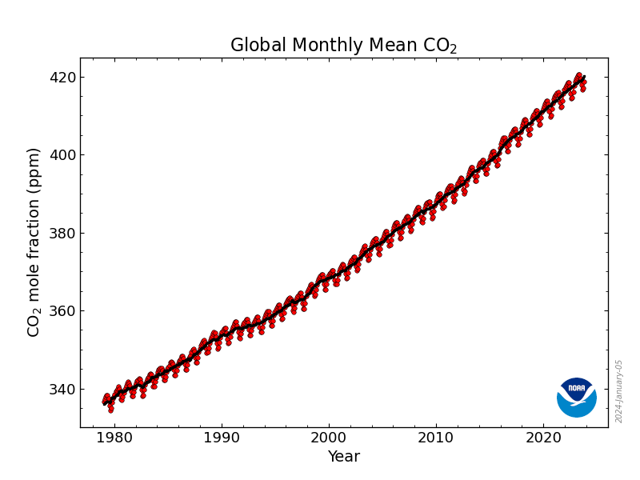
Existing SLE methods (1)
Those methods require an entire time series for season length estimation.
Those methods utilized periodogram and autocorrelation function (ACF) to estimate season length.
Peridogram
Season
length
ACF
Entire time series
SLE method
Existing SLE framework
9

Slide 10
Existing SLE methods (2)
Existing SLE methods use the Fast Fourier Transform (FFT) for periodogram computation with a cost of O(N log N).
N is the sliding window length.
These methods also utilize the ACF to estimate the season length, which also has a computational cost of O(N log N) due to inverse FFT.
Methods | Computational cost
 | Periodogram | ACF
AutoPeriod | O(N log N) | O(N log N)
SAZED | O(N log N) | O(N log N)
FindLength | - | O(N log N)
10

Slide 11
Our proposed method
We proposed the Online Season Length Estimation method (OnlineSLE).
OnlineSLE is a real-time season
length estimation method.
We reduced the time complexity of periodogram computation.
We proposed a novel method that
does not utilize ACF.
Methods | Computational cost
 | Periodogram | ACF
AutoPeriod | O(N log N) | O(N log N)
SAZED | O(N log N) | O(N log N)
FindLength | - | O(N log N)
OnlineSLE | O(N) | -
[1] J. Paparrizos et. al., “TSB-UAD: an end-to-end benchmark suite for univariate time-series anomaly detection”, VLDB, 15(8) , 2022.
[2] M. Toller et. al., “SAZED: parameter-free domain-agnostic season length estimation in time series data”, DMKD, 33(6), 2019.
[3] M. Vlachos, P. Yu, and V. Castelli, “On periodicity detection and structural periodic similarity”. SDM, 2005.
11

Slide 12
Outline
Backgroud and motivation
Related works
Proposed online season length estimation method
Experiment results
Conclusions
12
Notes:
C

Slide 13
Online season length estimation (OnlineSLE)
OnlineSLE identifies the season length (m) for each incoming data (x_{t}).
OnlineSLE consists of three steps:
Updating the sliding window
Peridogram
computation
Identify
season length
x_{t}
Season length
at t
Incoming data
13
Notes:
What is P(K)

Slide 14
Our framework: Step1
We maintain our sliding window using a First-in, First-out approach:
Removing the oldest data (x_{oldest}) from the sliding window (W)
Appending incoming data (x_{t}) to the sliding window
10 | 7 | 3 | … | 8 | 28 | 5 | 6
x_{oldest}
x_{t}
14

Slide 15
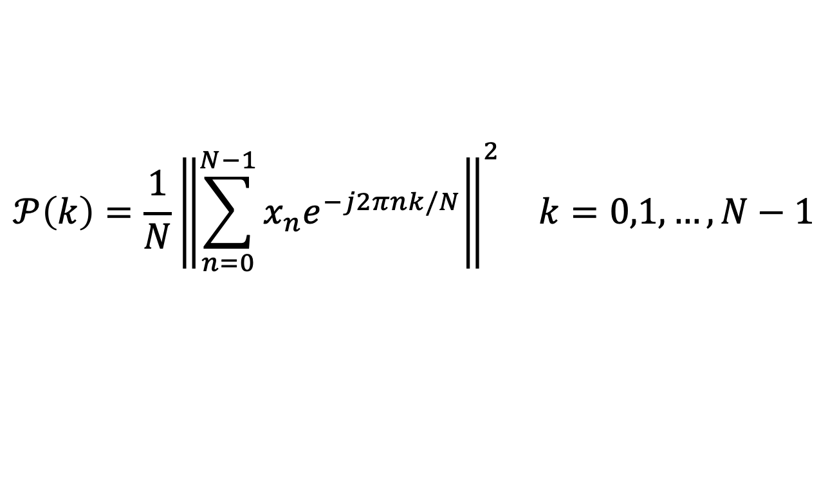
Our framework: Step2
Periodogram is a diagram in the frequency domain to identify the dominant repeating patterns within a time series
This analysis is utilized to estimate season length.
$$\begin{matrix}𝒫\left(k\right)=\frac{1}{N}{\left\|\sum_{n=0}^{N−1}{x_{n}e^{−j2πnk/N}}\right\|}^{2} & k=0,1,…,N−1\end{matrix}$$
Eq 1.
DFT(W)
Where : N = sliding window length
W = sliding window (x₀, x₁, . . . , x_{N−1}).
15

Slide 16
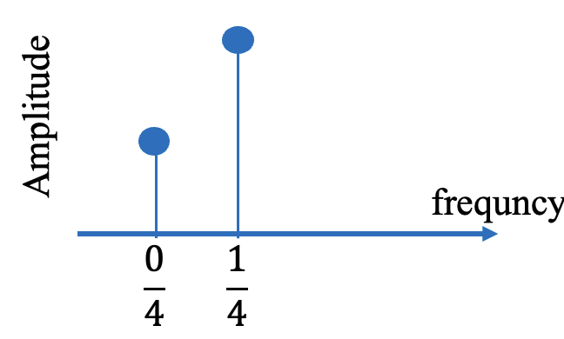
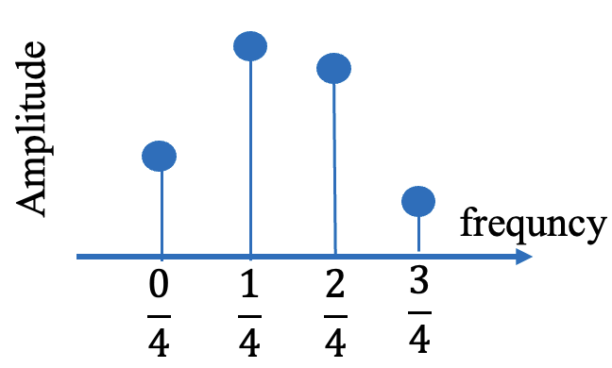
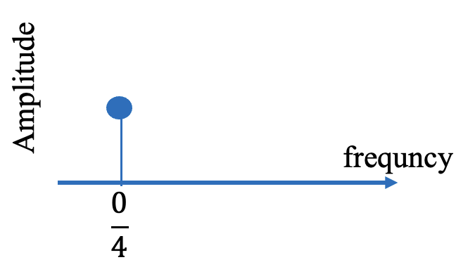
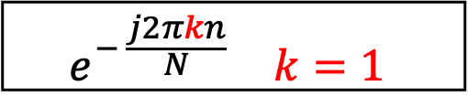
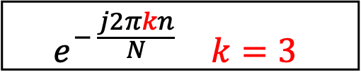
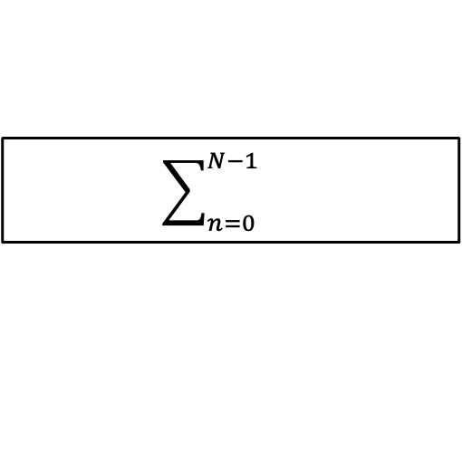
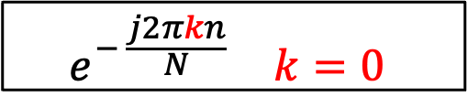

DFT
Value
Timestamp
The computation cost of DFT for each sliding window is O(N²).
Using FFT instead of DFT reduces the computation cost to O(N log N).
How can we reduce the computational cost further to O(N)?
The computation cost of DFT for each sliding window is O(N²).
$$\begin{matrix}e^{− \frac{j2πkn}{N}} & k=0\end{matrix}$$
$$\begin{matrix}e^{− \frac{j2πkn}{N}} & k=1\end{matrix}$$
$$\begin{matrix}e^{− \frac{j2πkn}{N}} & k=3\end{matrix}$$
$$\sum_{n=0}^{N−1}{}$$
$$\sum_{n=0}^{N−1}{0}$$
$$\sum_{n=0}^{N−1}{0}$$
16
Notes:
O(N). Change
K >>> highlight

Slide 17
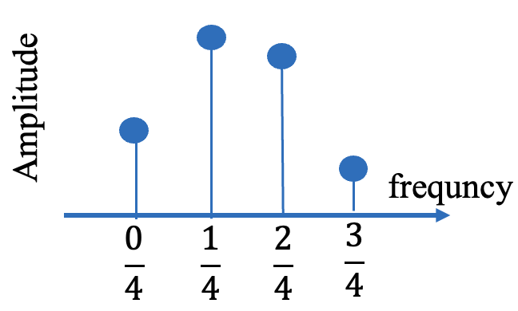
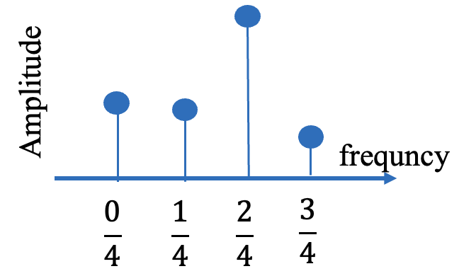
Sliding window at timestamp t-1
Sliding window at timestamp t
x_{t-N}
x_{t}
DFT (k=0)
DFT (k=0)
Add x_{t} into DFT result at t-1
Subtract x_{t-N} from DFT result at t-1
17

Slide 18
Sliding window at timestamp t-1
Sliding window at timestamp t
x_{t-N}
x_{t}
DFT (k=1)
DFT (k=1)
Add x_{t} into DFT result at t-1
Subtract x_{t-N} from DFT result at t-1
18

Slide 19
Sliding DFT (SDFT)
Sliding DFT is a recursive algorithm that performs DFT calculations by utilizing the pervious DFT result [4].
Subtract x_{t-N} from DFT result at t-1
$$SDFTt\left(W\right)=e^{\frac{j2πk}{N}}\left[{SDFT}_{t−1}\left(W\right)+\text{x}\text{t}−\text{x}\text{t}\text{−}N\right]$$
Eq 2.
Add x_{t} into DFT result at t-1
[4] E. Jacobsen and R. Lyons. The sliding DFT. IEEE Signal Processing Magazine, 20(2), 2003.
19
Notes:
Sliding DFT is a recursive algorithm that performs DFT calculations by utilizing the previous DFT result [2].

Slide 20


Our framework: Step3
It identifies the frequency that corresponds to the highest amplitude as:
It transforms frequency f to season length m in the time domain as:
$$\underset{f}{f= argmax}{(𝒫\left(k\right))}$$
Eq 3.
$$m=\frac{1}{f}$$
Eq 4.
20

Slide 21
OnlineSLE
Peridogram
computation
Identify
season length
Season length at timestamp t
m = 1/0.05
= 20
W in the time domain (season length = 20)
Peridogram in the frequcy domain
21
Notes:
Power >>> change

Slide 22
Outline
Backgroud and motivation
Related works
Proposed online season length estimation method
Experiment results
Conclusions
22

Slide 23
Experiments setting
Dataset:
We utilized eight synthetic and two real-world datasets.
Existing methods:
We utilized three methods and OnlineSLE for this evaluation*.
Test enviroment:
MacBook Air (2022) with 8 CPU cores (M2) 16 GB RAM
Three methods are appeared in as follows:
[1] J. Paparrizos et. al., “TSB-UAD: an end-to-end benchmark suite for univariate time-series anomaly detection”, VLDB, 15(8) , 2022.
[2] M. Toller et. al., “SAZED: parameter-free domain-agnostic season length estimation in time series data”, DMKD, 33(6), 2019.
[3] M. Vlachos, P. Yu, and V. Castelli, “On periodicity detection and structural periodic similarity”. SDM, 2005.
23

Slide 24
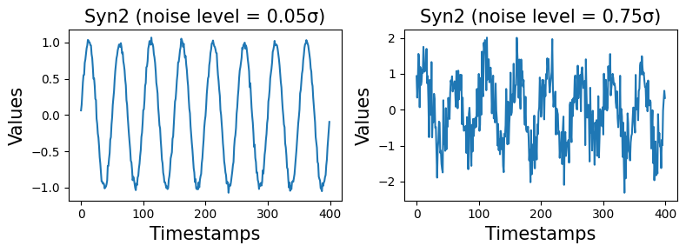
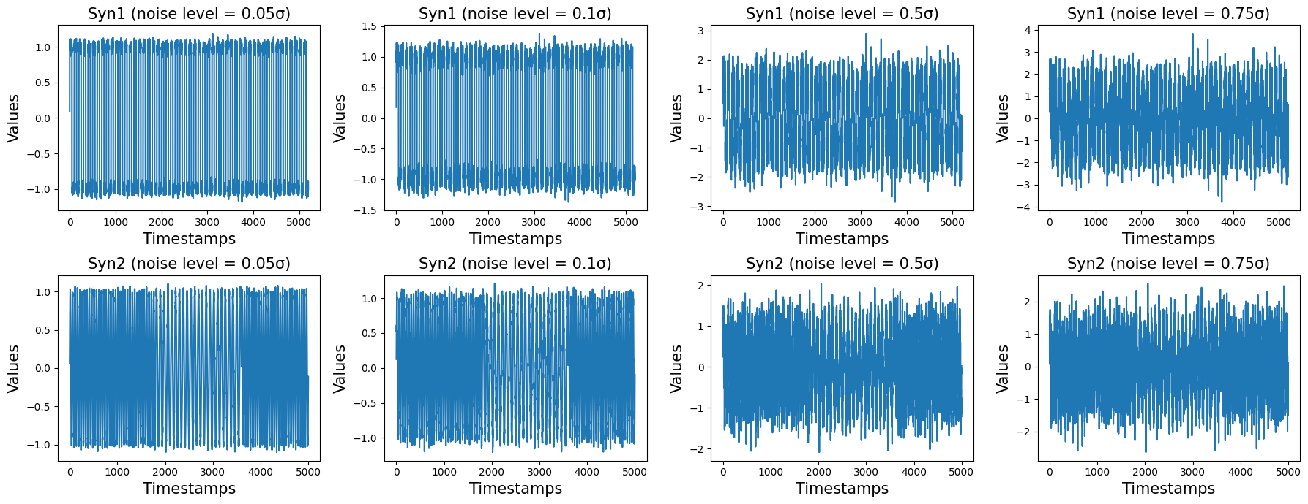
Synthetic datasets
We generated eight synthetic datasets and injected random Gaussian noise into each dataset.
24

Slide 25
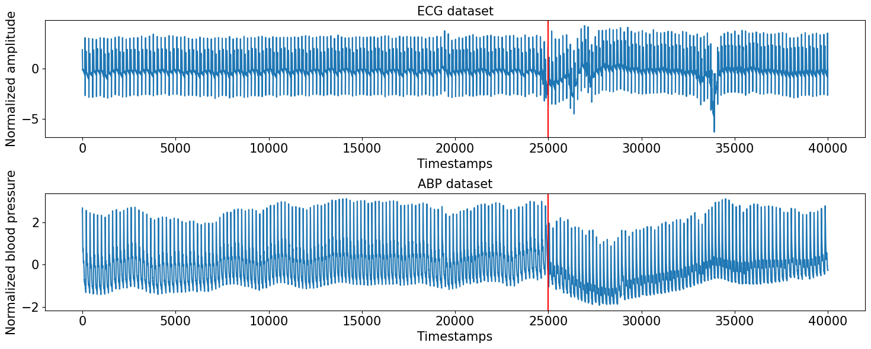

Real-world datasets
We utilized two real-world datasets: Electrocardiogram (ECG) and Atrial Blood Pressure (ABP)[5].
Red lines refers that tilt table was rapidly rotated to the stand-up position
[5] S. Gharghabi, Y. Ding, C.-C. M. Yeh, K. Kamgar, L. Ulanova, and E. Keogh, “Matrix profile VIII: Domain agnostic online semantic segmentation at superhuman performance levels”, ICDM, 2017.
25

Slide 26
Evaluation metrics
Time performance:
We measure the average latency of processing for each sliding window.
Accuracy rate:
We count the numbering of sliding windows where the method provides a season length that matches the ground truth.
We compute the accuracy ratio with the results of step 1 by the total number of sliding windows.
26

Slide 27
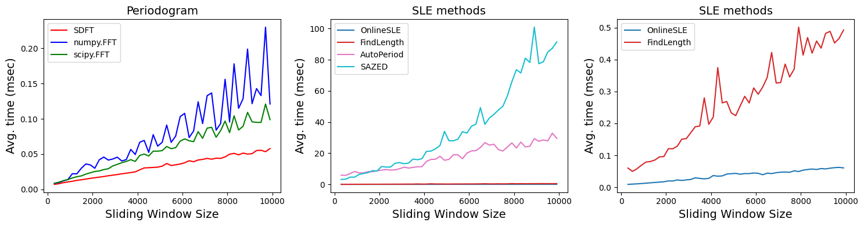
Time performance
SDFT achieved the fast computation that FFT with well-known libraries of python (SciPy, NumPy).
OnlineSLE achieved the fast computation that existing method.
27

Slide 28
Accuracy rate with synthetic datasets
OnlineSLE achieved a high accuracy rate comparing with existing methods.
High noise level impacted to ACF that affect to accuracy rate.
Method | Syn1 |  |  |  | Syn2
 | 0.05σ | 0.10σ | 0.50σ | 0.75σ | 0.05σ | 0.10σ | 0.50σ | 0.75σ
AutoPeriod | 1.00 | 1.00 | 0.92 | 0.63 | 0.70 | 0.69 | 0.37 | 0.31
FindLength | 1.00 | 1.00 | 0.91 | 0.47 | 0.68 | 0.68 | 0.34 | 0.21
SAZED | 1.00 | 1.00 | 0.00 | 0.00 | 0.83 | 0.65 | 0.55 | 0.51
OnlineSLE | 1.00 | 1.00 | 1.00 | 1.00 | 0.91 | 0.91 | 0.92 | 0.92
28
Notes:
ACF - PEriodogr

Slide 29
Accuracy rate with real world datasets (1)
The ±0% setting refers to the exact match of the estimated season length with the ground truth.
The ±20% setting allows for a 20% error from the ground truth in the accuracy rate of season length estimation.
Result = 100
±0% > True
±20% > True
Result = 117
±0% > False
±20% > True
80
Ground truth
100
120
29

Slide 30
Accuracy rate with real world datasets (2)
OnlineSLE achieved a high accuracy rate with a ±0% setting.
Other methods achieved a higher accuracy rate than OnlineSLE with a ±20% setting.
Method | ECG |  | ABP
 | ±0% | ±20% | ±0% | ±20%
AutoPeriod | 0.06 | 0.96 | 0.02 | 0.59
FindLength | 0.53 | 0.93 | 0.02 | 1.00
SAZED | 0.00 | 0.96 | 0.02 | 0.99
OnlineSLE | 0.86 | 0.86 | 0.60 | 0.66
30

Slide 31
Limitation of OnlineSLE
We found the influence sliding window size issue with accuracy rate.
This is issue correspond to resolution DFT coefficients.
Existing methods utilize ACF to solve this issue.
Algorithm | Accuracy rate (Syn2)
 | N = 300 | N = 400 | N = 500
AutoPeriod | 0.526 | 0.696 | 0.809
FindLength | 0.518 | 0.683 | 0.791
SAZED | 0.558 | 0.826 | 0.796
OnlineSLE | 0.584 | 0.910 | 0.546
31

Slide 32
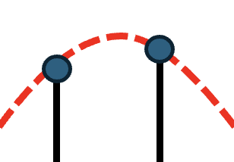
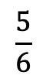
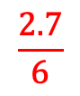
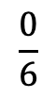
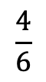
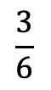
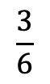
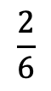
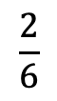
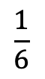
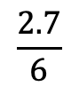
Resolution DFT coefficients issue
The highest amplitude of the DFT might not represent the actual highest amplitude in the Fourier transform.
k in DFT must be a positive integer.
Actual highest amplitude
Fourier
transfrom
DFT
Amplitude
Amplitude
Frequency
Frequency
$$\frac{2}{6}$$
$$\frac{2.7}{6}$$
$$\frac{3}{6}$$
$$\frac{2.7}{6}$$
$$\frac{0}{6}$$
$$\frac{1}{6}$$
$$\frac{2}{6}$$
$$\frac{3}{6}$$
$$\frac{4}{6}$$
$$\frac{5}{6}$$
32

Slide 33
Outline
Backgroud and motivation
Related works
Proposed online season length estimation method
Experiment results
Conclusions
33
Notes:
C

Slide 34
Conclusion
Our proposed method achieved fast computation with a high accuracy rate.
Alternative methods may provide more efficient results for datasets with a simple seasonality.
Further work
We will solve the influence of the sliding window size issue.
We plan to integrate the OnlineSLE into the time series decomposition algorithm.
34

Slide 35


Thank You ありがとうございます。
onlineSLE
Source code and dataset
for reproduction
GitHub : thanapol2/onlineSLE

Slide 36


Our research
We proposed an adaptive seasonal-trend decomposition (ASTD) method for streaming time series data with transitions and fluctuations in seasonality.
We solved the influence of the window size issue in this ASTD.
We show experimental results with 60 real-world datasets from various fields.
biology, climatology, economics, and more…
Research track
ASTD_ECMLPKDD

Slide 37
References
J. Paparrizos et. al., “TSB-UAD: an end-to-end benchmark suite for univariate time-series anomaly detection”, VLDB, 15(8) , 2022.
M. Toller, T. Santos, and R. Kern., “SAZED: parameter-free domain-agnostic season length estimation in time series data”, Data Mining and Knowledge Discovery, 33(6), 2019.
M. Vlachos, P. Yu, and V. Castelli, “On periodicity detection and structural periodic similarity”. In SIAM International Conference on Data Mining, 2005.
E. Jacobsen and R. Lyons. “The sliding DFT”. IEEE Signal Processing Magazine, 20(2), 2003.
S. Gharghabi et. al., “Matrix profile VIII: Domain agnostic online semantic segmentation at superhuman performance levels”,In ICDM, 2017.

